Slide 1
Figures for Smith et al. 2020

Slide 2
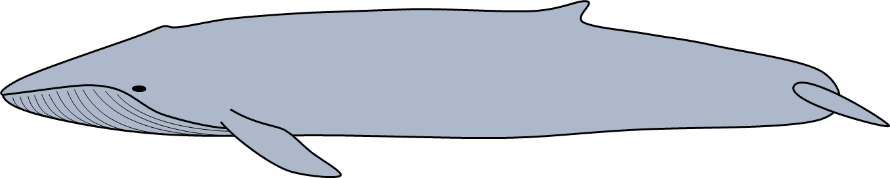
flow
path of flukes
orientation of fin
α
drag
path of animal
thrust
lift
Notes:
Figure 1. Adaptation from Shadwick (2005) showing the forces acting on the tail of a thunniform swimmer such as a blue whale during active oscillatory fluking of the tail. The heaving motion of the tail creates a pressure imbalance between the top and bottom faces of the fluke that results in the generation of a lift force perpendicular to the path of the flukes and a thrust force in the forward direction of travel of the animal.

Slide 3
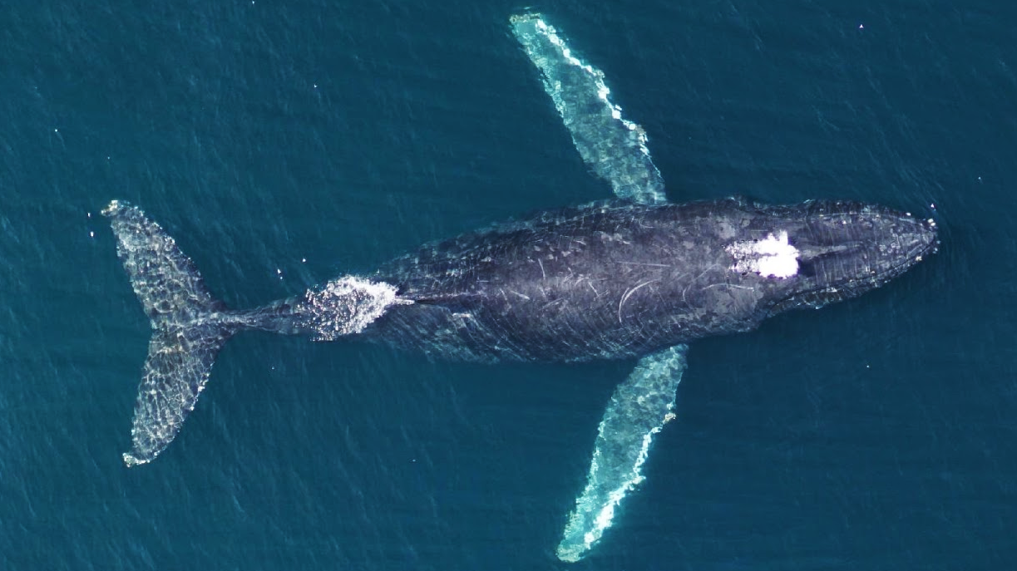
Notes:
Figure 2. Representative UAS drone image of a humpback whale showing the morphometric measurements taken from each animal. The white line corresponds to the total length (in meters) from the tip of the lower jaw to the caudal midpoint of the tail. The chord length of the fluke (in meters) is denoted by the red line running from the cranial insertion of the fluke onto the peduncle to the caudal midpoint of the tail. The green shaded region corresponds to the tail area (in m²) comprising the entirety of the flukes and the peduncle region caudal to the cranial fluke insertions. Make lines thicker.

Slide 4
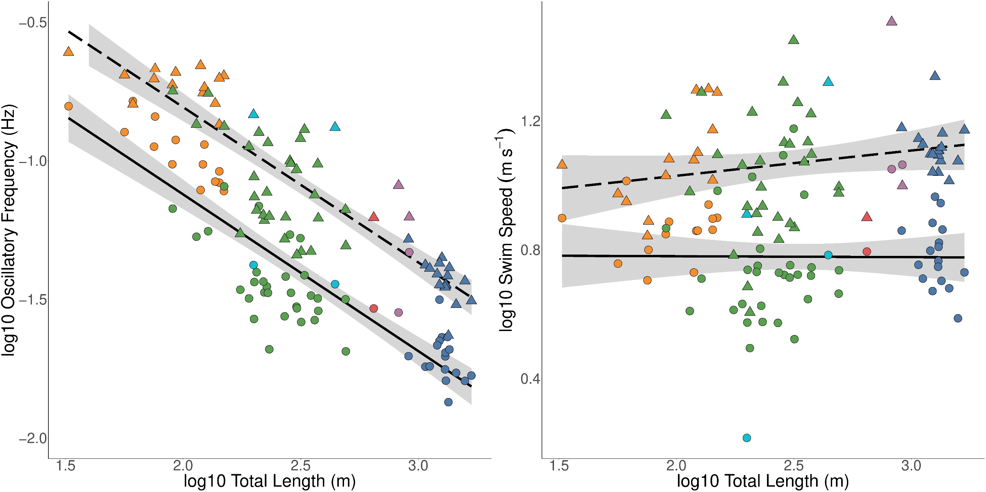
A
B
● ▲ Blue
● ▲ Humpback
● ▲ Minke
● ▲ Fin
● ▲ Bryde’s
● ▲ Sei
Notes:
Figure 3. Linear regressions showing the log¹⁰ of total body length (m) versus the A) oscillatory frequency (Hz) and B) swim speed (m s⁻¹) for both routine swimming (solid line) and lunge-associated swimming (dashed line). Each point corresponds to the mean value for a single individual whale and a single swimming mode (● circle: routine; ▲ triangle: lunge-associated).

Slide 5
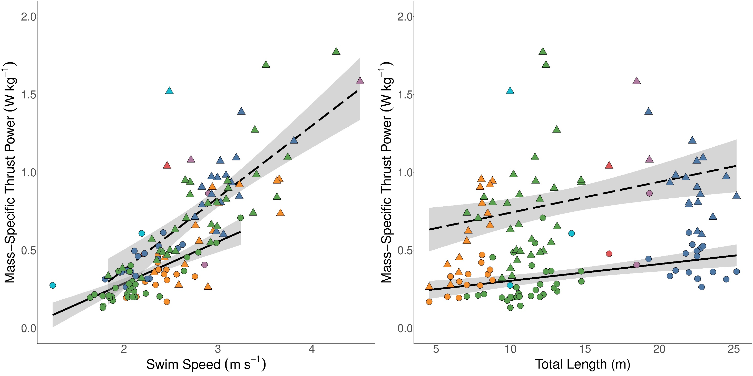
A
B
● ▲ Blue
● ▲ Humpback
● ▲ Minke
● ▲ Fin
● ▲ Bryde’s
● ▲ Sei
Notes:
Figure 4. Linear regressions showing A) swim speed (m s⁻¹) and B) total body length (m) versus mass-specific thrust power output (W kg⁻¹) for both routine swimming (solid line) and lunge-associated swimming (dashed line). Each point corresponds to the mean value for a single individual whale and a single swimming mode (● circle: routine; ▲ triangle: lunge-associated). One point was removed above the visual range of each figure (Bryde’s whale: mean swim speed = 3.74 m s⁻¹; total body length = 14.1 m; mean mass-specific thrust power output = 2.60 Watts kg⁻¹).

Slide 6
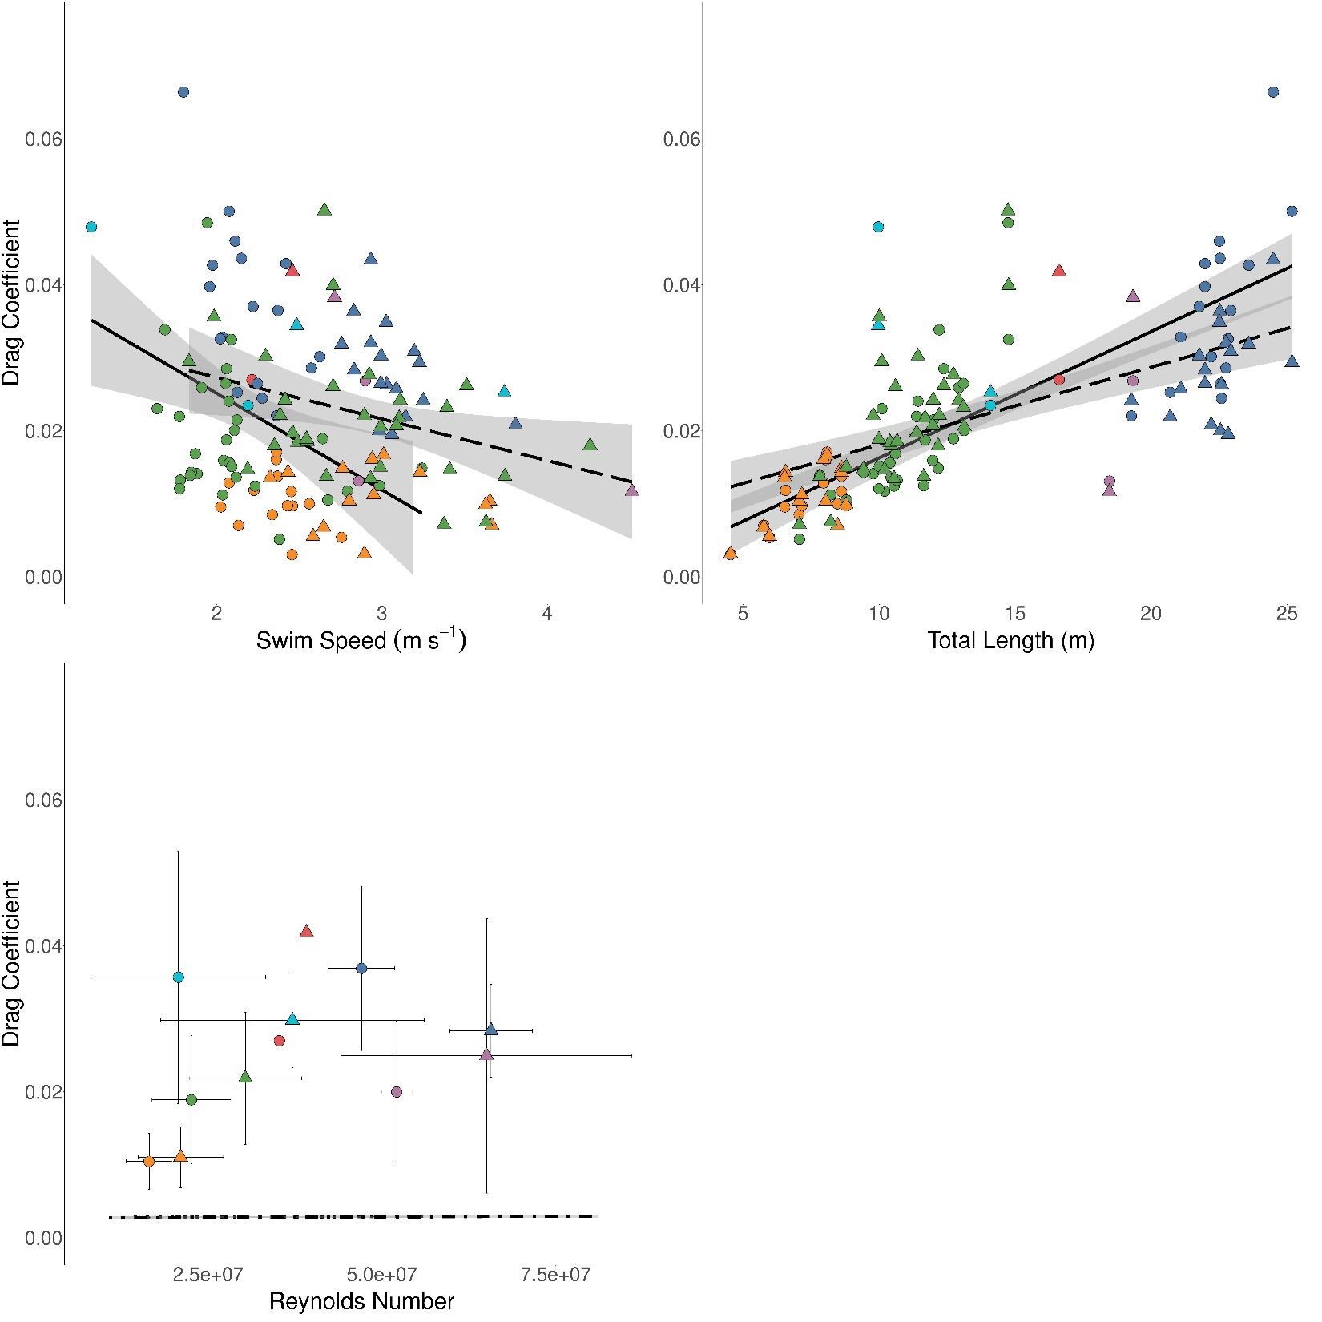
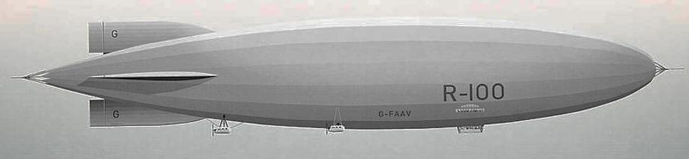
A
● ▲ Blue
● ▲ Humpback
● ▲ Minke
● ▲ Fin
● ▲ Bryde’s
● ▲ Sei
B
C
Whale: Control surfaces intact and active fluking
R100 Model: Control surfaces removed and non-fluking travel
Notes:
Figure 5. Linear regressions showing A) swim speed (m s⁻¹), B) total body length (m), and C) Reynolds number versus the drag coefficient (dimensionless) for both routine swimming (solid line) and lunge-associated swimming (dotted line). Each point corresponds to the mean value for a single individual whale and a single swimming mode (● circle: routine; ▲ triangle: lunge-associated). One point was removed above the visual range of each figure (blue whale: mean swim speed = 1.68 m s⁻¹; total body length = 24.1 m; mean Reynolds number = 3.9e+07; mean drag coefficient = 0.131). Dot-dash lines shown in C) are linear regressions of Reynolds number versus drag coefficient for simple rigid-body model comparison using equations derived from Hoerner (1965). Illustration shows a swimming blue whale and image shows an R100 rigid-body as visual representations of the data shown in C).

Slide 7
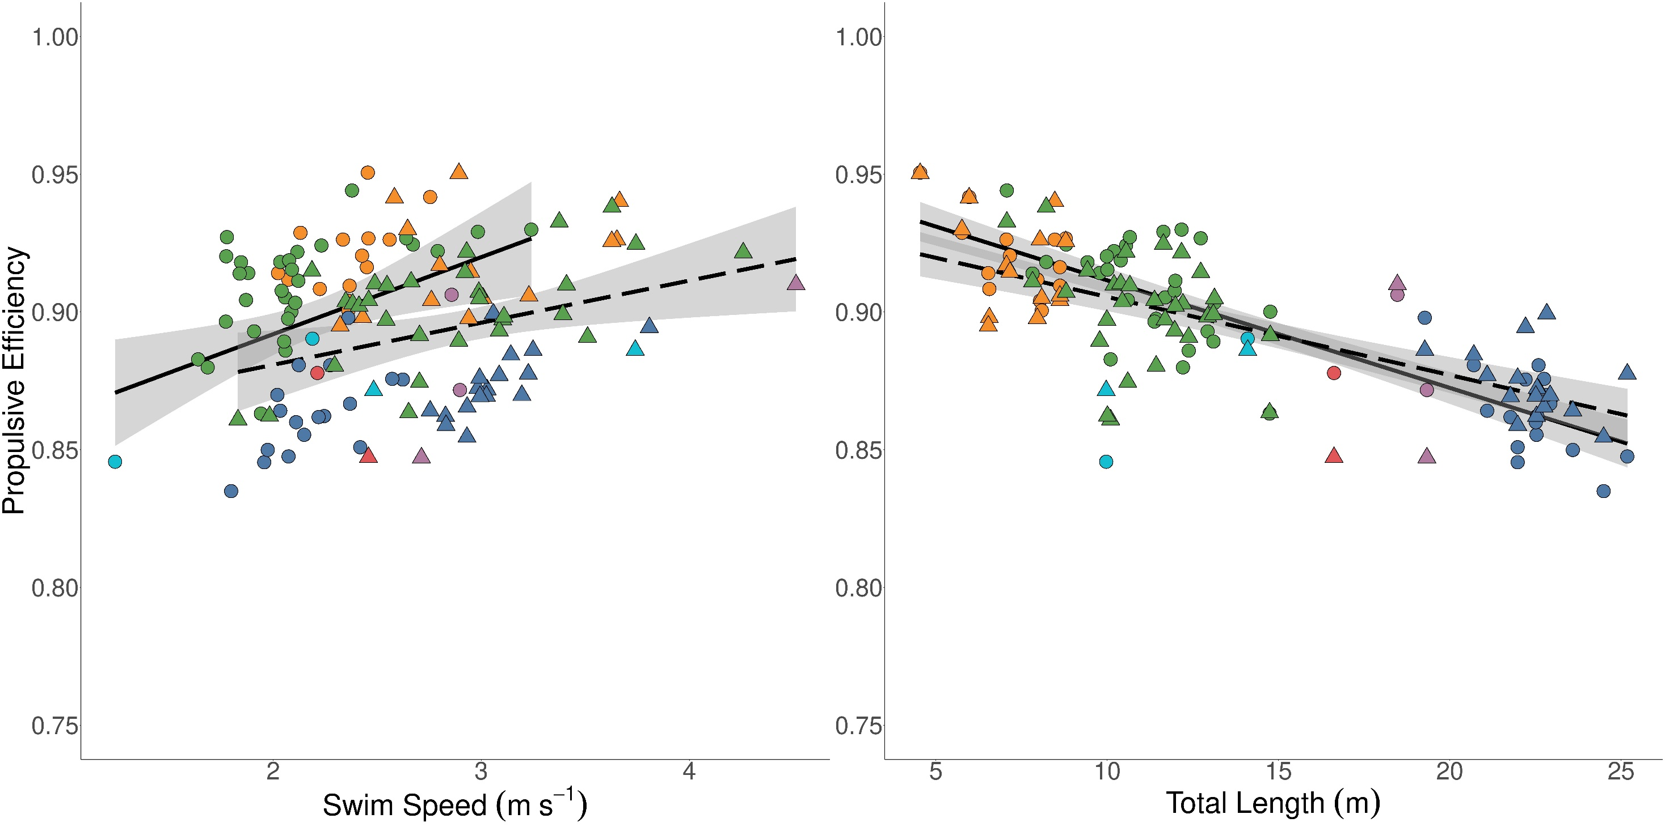
A
B
● ▲ Blue
● ▲ Humpback
● ▲ Minke
● ▲ Fin
● ▲ Bryde’s
● ▲ Sei
Notes:
Figure 6. Linear regressions showing A) swim speed (m s⁻¹) and B) total body length (m) versus propulsive efficiency (dimensionless) for both routine swimming (solid line) and lunge-associated swimming (dotted line). Each point corresponds to the mean value for a single individual whale and a single swimming mode (● circle: routine; ▲ triangle: lunge-associated). One point was removed above the visual range of each figure (Bryde’s whale: mean swim speed = 3.74 m s⁻¹; total body length = 14.1 m; mean mass-specific thrust power output = 2.60 Watts kg⁻¹).

Slide 8
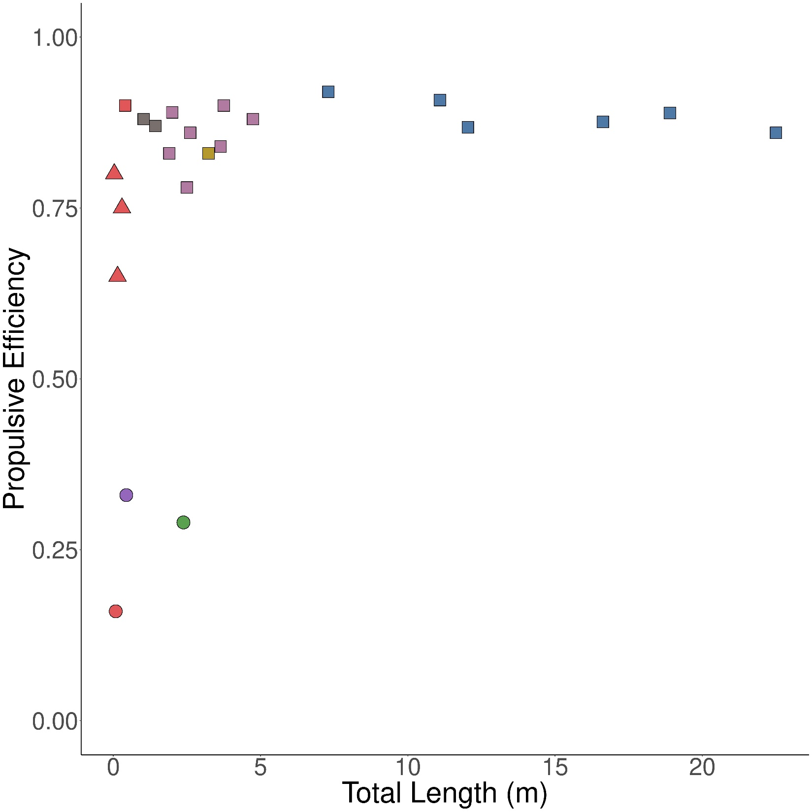


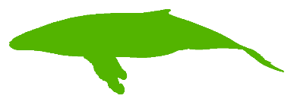
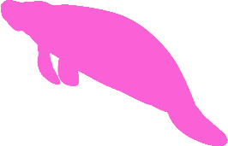
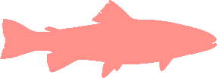
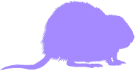

Pinnipeds
Odontocetes
Mysticetes
Sirenians (Manatee)
Fish
Rodents (Muskrat)
Humans
Notes:
Figure 7. Propulsive efficiency versus total body length (m) for species from different morphological and taxonomic groups and use different swimming modes (● circle: drag-based paddling; ▲ triangle: undulatory swimming; ■ square: oscillatory swimming). The mysticete cetaceans are the mean species-level data from our present study. Silhouettes correspond to each group by rough position and color.

Slide 9
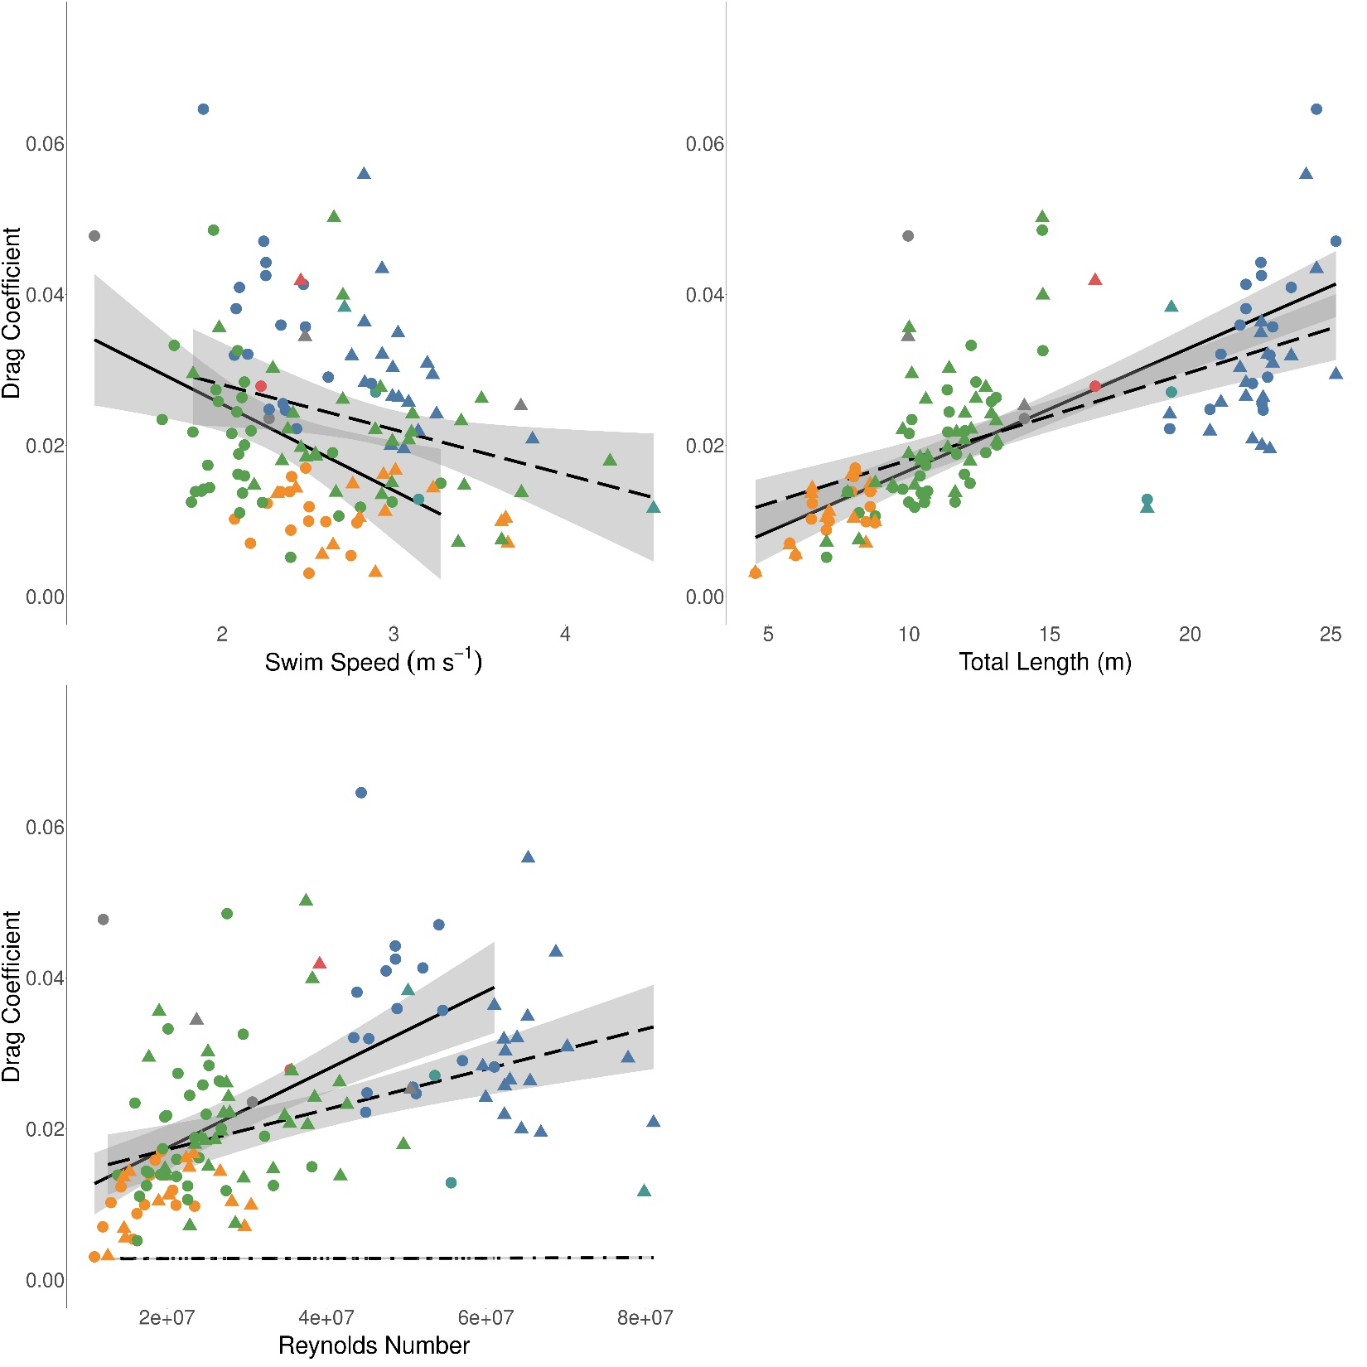
A
● ▲ Blue
● ▲ Humpback
● ▲ Minke
● ▲ Fin
● ▲ Bryde’s
● ▲ Sei
B
C
Whale: Control surfaces intact and active fluking
R100 Model: Control surfaces removed and non-fluking travel
Notes:
Figure 5. Linear regressions showing A) swim speed (m s⁻¹), B) total body length (m), and C) Reynolds number versus the drag coefficient (dimensionless) for both routine swimming (solid line) and lunge-associated swimming (dotted line). Each point corresponds to the mean value for a single individual whale and a single swimming mode (● circle: routine; ▲ triangle: lunge-associated). One point was removed above the visual range of each figure (blue whale: mean swim speed = 1.68 m s⁻¹; total body length = 24.1 m; mean Reynolds number = 3.9e+07; mean drag coefficient = 0.131). Dot-dash lines shown in C) are linear regressions of Reynolds number versus drag coefficient for simple rigid-body model comparison using equations derived from Hoerner (1965). Illustration shows a swimming blue whale and image shows an R100 rigid-body as visual representations of the data shown in C).

